Slide 1

Analysis
Made by-
Vikas Budhani
Ritu Ghansela

Slide 2
OBJECTIVEs
To analyze Ecommerce daily working and growth of the company and Lacking of the company.

Slide 3
Creating Database And Importing CSV file
create database Project
use project
select * from login_logs;
select * from sales_orders;
select * from sales_orders_items;

Slide 4
Renaming Column Names
exec sp_rename 'sales_orders.fk_depot_id','depot_id','column';
exec sp_rename 'sales_orders.fk_buyer_id','buyer_id','column';
exec sp_rename 'sales_orders_items.fk_product_id','product_id', 'column';
exec sp_rename 'sales_orders_items.fk_order_id','order_id', 'column';

Slide 5
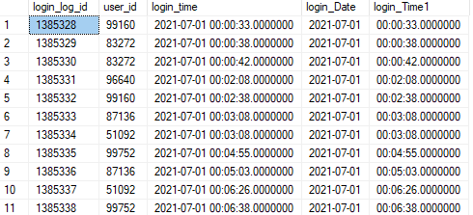
Creating View of loggers & Extracting Date and Time
create view login_new as select login_log_id,user_id, convert(date,[login_time]) as login_Date,
CONVERT(varchar(15), CAST(login_time AS TIME), 100) as login_Time1 from login_logs;

Slide 6
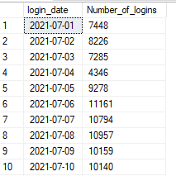
select login_date, count(login_log_id) as Number_of_logins
from login_new
group by login_Date
order by login_Date
Created table of Login on the Bases of daily dates of July month.
Output of query

Slide 7
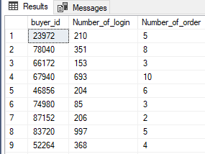
create view number_of_login as
select user_id,count(login_log_id) as Number_of_login from login_new group by user_id;
create view number_of_orders as
select buyer_id,count(order_id) as Number_of_order from sales_orders group by buyer_id;
select * from number_of_login;
select * from number_of_orders;
select a.buyer_id,b.Number_of_login,a.Number_of_order from number_of_orders as a
join number_of_login as b on a.buyer_id=b.user_id;
Created a view of number of login
and numbers of order palced by buyers
After that we join the table ---

Slide 8
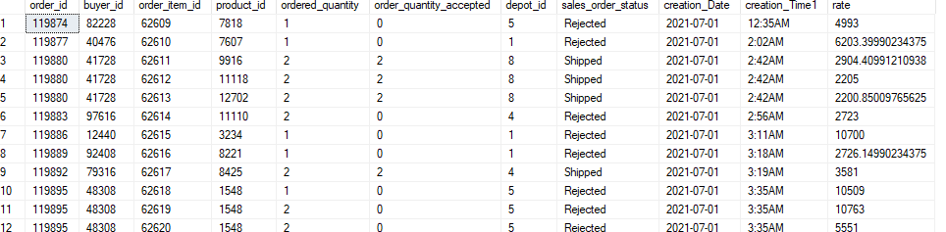
create view sales_order_details_new as
select a.order_id,a.buyer_id,b.order_item_id,b.product_id,b.ordered_quantity,b.order_quantity_accepted,a.depot_id,a.sales_order_status,
convert(date,[creation_time]) as [creation_Date],CONVERT(varchar(15), CAST(creation_time AS TIME), 100) as [creation_Time1],
b.rate from sales_orders as a left join sales_orders_items as b on a.order_id=b.order_id ;

Slide 9


select top 1 year(creation_Date) as Years,product_id,count(product_id) as number_of_selling_product
from sales_order_details_neww
group by year(creation_Date),product_id
having year(creation_Date)=2021
order by number_of_selling_product desc;
select top 1 year(creation_Date) as Years,product_id,count(product_id) as number_of_selling_product
from sales_order_details_neww
group by year(creation_Date),product_id
having year(creation_Date)=2022
order by number_of_selling_product desc;

Slide 10
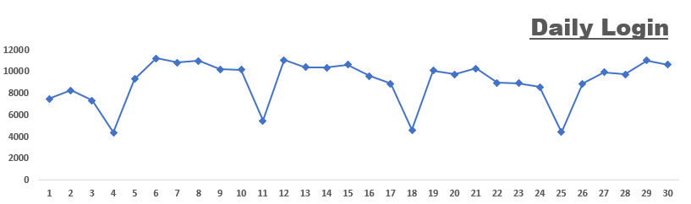
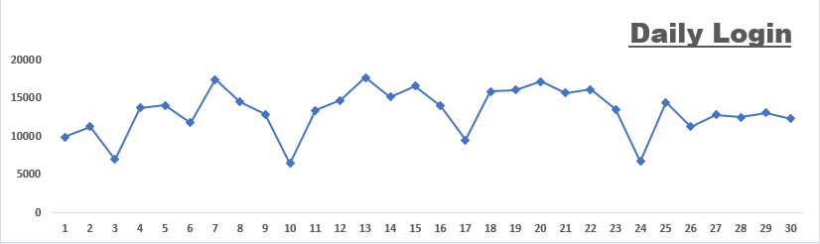
Daily login Trend year wise
Trend of 2021
We have highest login in 29 July
Trend of 2021
We have the highest login on 13 July

Slide 11
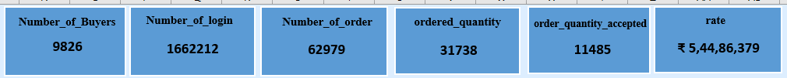
KPI’S of July 202 & 2022
There are 20488 buyers who actually order the product, lets see year wise.
The KPI contain 2021 data
The KPI contain 2022 data

Slide 12
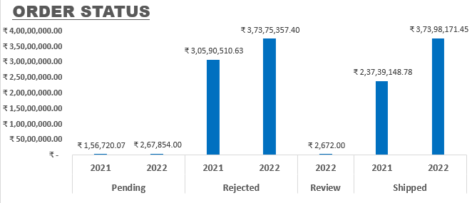
Order Status
As compared to 2021 Order status with 2022-
In 2021 there is an increase in pending orders in 2022.
In 2022 there is a larger number of order was rejected. It might be a barrier of growth of the business.
In 2022 the shipped order is far better then 2021.

Slide 13
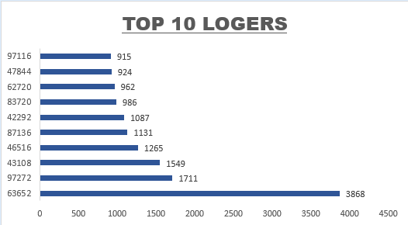
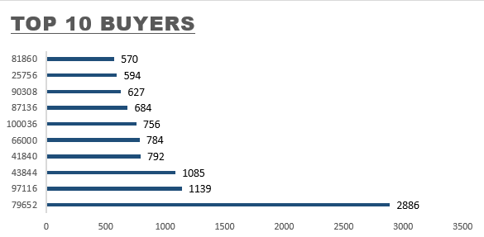
TOP 10 Loggers and Buyers in 2021

Slide 14
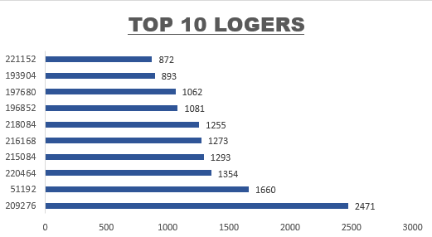
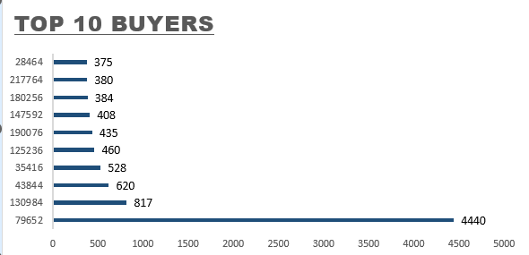
TOP 10 Loggers and Buyers in 2022

Slide 15
Insights
Daily login trend and highest login in 2021 on 6th July – 11,161 and in 2022 on 13th July – 17,570.
Top-selling product in 2021 is product id 10235 ordered 550 times and in 2022 product id 8444 ordered 485 times.
Top rejected products in 2021 are product id 10235 Rejected 257 times and in 2022 product id8444 rejected 250 times.
Top logger id 63652 in 2021 and id 209276 in 2022.
Top buyer id 79652 in 2021 and id 79652 in 2022. same person.
We have found that rejected order 60% and 39% shipped orders are there in 2021 and 54% rejected orders and 46% shipped orders.

Slide 16
Analysis -
The business grew by 7% according to orders shipped.
Number of logins increased by 2%.
In 2021 the rejected orders percentage is 60% and now in 2022, there is 54%. The rejection percentage decreased by 6%.
Lacking -
Over all Rejected orders percentage is 57 % which is not good for the company’s growth.
Top-selling Products were out of stock.
Suggestion-
Increase Manpower for accepting orders.
Check or debug your application.
Produce more quantity of top-selling products.

Slide 17
THANK YOU

